Slide 1
Bus Transportation
A bus is a road vehicle designed to carry many passengers. Bus is a clipped form of the Latin word omnibus meaning “(carriage) for all”, and appeared in London in 1829
History of Bus
Horse-drawn buses were used from the 1820s
followed by steam buses in the 1830s
electric trolleybuses in 1882
The first internal combustion engine buses, or motor buses, were used in 1895

Slide 2
Types of Buses
School buses
Coach buses
Public transit buses
Luxury Motorcoach
Mini-Coach
Day (Executive) Coach
Double-Decker Vehicle
Wheelchair Accessible Vehicle
Sleeper Coach
Luxury Sedan
Charter Bus / Deluxe Motor Coach

Slide 3
Charter Bus

Slide 4
Entertainer / Sleeper / Tour Bus

Slide 5
Executive Coach / Day Coach

Slide 6
Limo Bus / Party Bus

Slide 7
Double Decker Bus

Slide 8
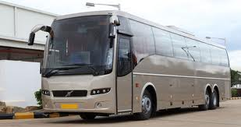
Volvo Bus

Slide 9
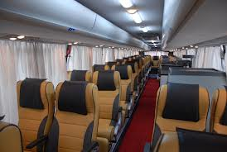
Volvo Bus

